Slide 1
MEASUREMENT AND MONITORING OF SOIL MOISTURE USING CLOUD IOT AND AWS RDS
Professor
Dr. Ajay Gupta
Presented by
Sampath Talluri
Meghana Gadde

Slide 2
Hardware & Software Requirements
Hardware Requirements
Microcontroller : Node MCU
Sensors : Soil Moisture Sensor
Actuators : Single Chanel Relay, Water Motor
Others : Bread Board, Jumper Cables, 9V Battery
Software Requirements
Operating System : Windows 7, 8 or 10
Language : Arduino Programming, PHP
Data Base : MySQL Server on AWS
Developer Tools : Arduino IDE, XAMP web server,
MySQL Workbench, AWS Educate Account

Slide 3
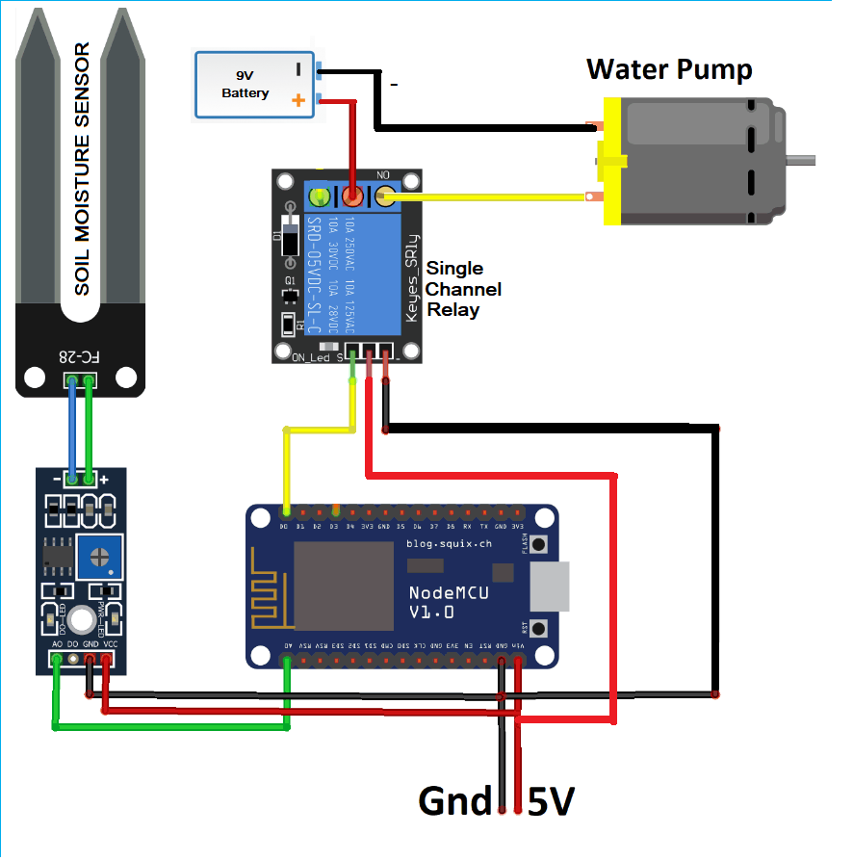
Circuit Diagram:

Slide 4
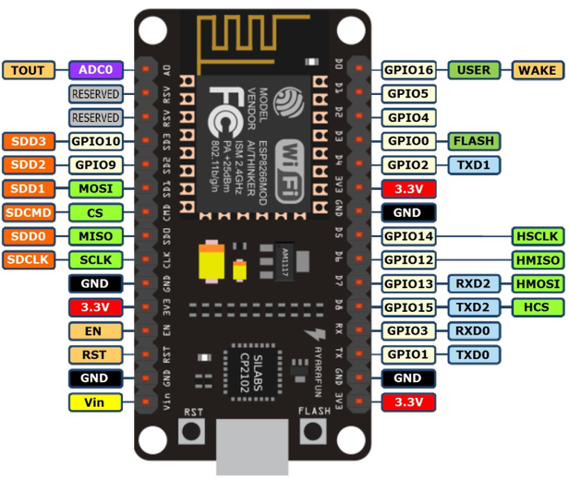
NODE MCU (V1.0)
NodeMCU V1.0 is an open source IoT platform with ESP8266-12E chips
Low-cost, breadboard friendly
Micro USB cable can be used to powered this board
This modules aimed for developing ESP8266 based Lua IoT applications

Slide 5
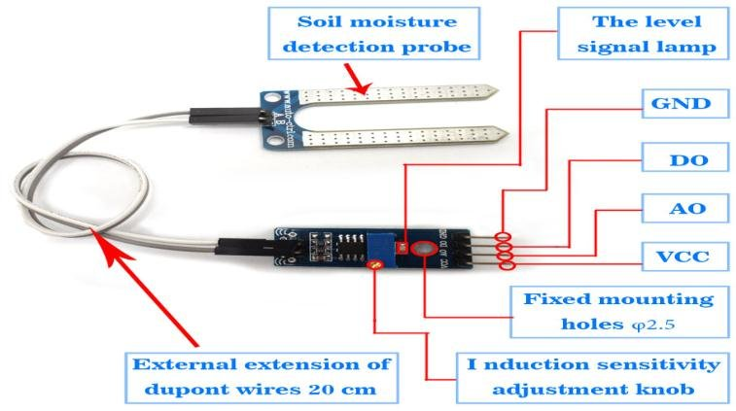
SOIL MOISTURE SENSOR
A digital signal that basically informs if the ground is dry or not
An analog signal that can be used to estimate how humid the soil is
GND is ground

Slide 6
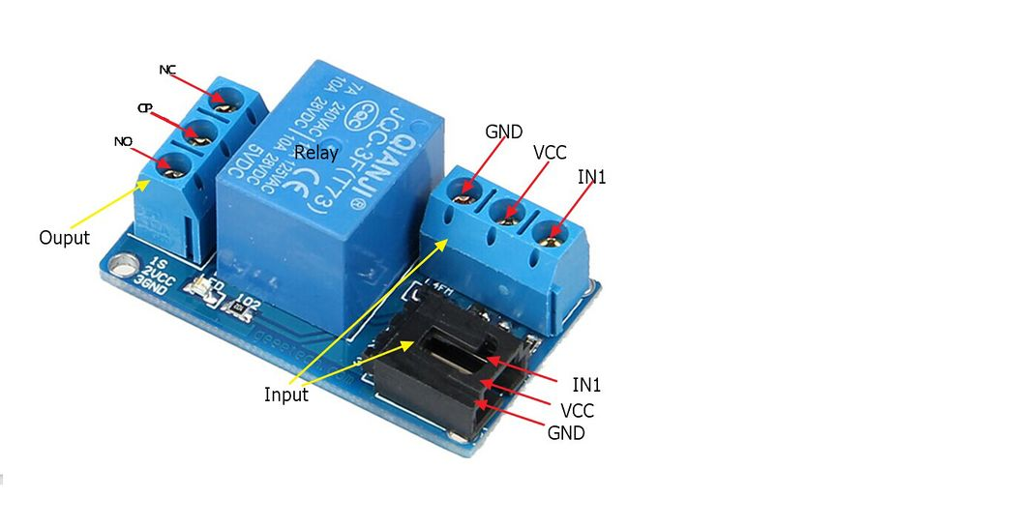
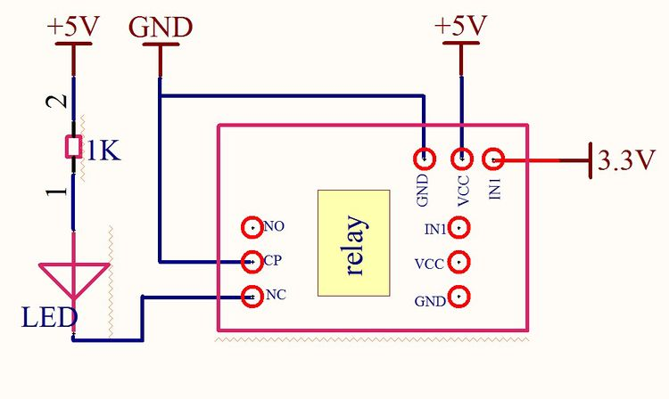
SINGLE CHANNEL RELAY MODULE
Good in safety. In power system and high voltage system, the lower current can control the higher one.
1-channel high voltage system output, meeting the needs of single channel control
Wide range of controllable voltage.
Being able to control high load current, which can reach 240V, 10A

Slide 7
QUESTIONS ?

